Slide 1
Bleeding time
&
CLOTTING TIME

Slide 2
relevance
Bleeding after injury is a common experience for most of us. But bleeding stops automatically within a few minutes.
However, suspicion of a disease arises when there is frequent & prolonged bleeding with minor injuries, such as during shaving, cutting of nails, or a fall on the knees.

Slide 3
hemostasis
Hemostasis: refers to the process of stoppage of bleeding after blood vessels are punctured, cut, or otherwise damaged.
Hemostasis involves a series of events which leads to clot formation and prevention of further blood loss. These include:

Slide 4
hemostasis
Fibrinolysis (dissolution of the clot).
Vasoconstriction (contraction of injured blood vessels).
Platelet plug formation.
Formation of a blood clot.
Fibrinolysis (dissolution of the clot).

Slide 5
Tests for hemostasis
Capillary fragility test of Hess (tourniquet test)
Platelet count
Bleeding time (BT)
Clotting time (CT)
Other tests include: prothrombin consumption test, partial thromboplastin test, thrombin time (TT), and special tests, including assaying of clotting factors.

Slide 6
Bleeding time
Bleeding Time (BT): is the time interval between the skin puncture and spontaneous, unassisted (i.e. without pressure) stoppage of bleeding.
The BT test is an in vitro test of platelet function.
Notes:
Vasoconstriction & platelates plug will act in case of bleeding time experiment

Slide 7
BLEEDING TIME
Bleeding time depends on:
Depth of the wound.
Degree of hyperemia of the skin puncture site.
Number of platelets and their functional status.
Functional status of the blood vessels.
Temperature.
Notes:
Temperature: In cold weather, low temperature promotes vasoconstriction and thus shortens BT.

Slide 8
Normal value
Normal bleeding time = 1–5 minutes.
The BT is prolonged in purpura while it is usually normal in hemophilia.
Notes:
The term purpura is derived from the purple-colored petechial hemorrhages and bruises in the skin. The blood that leaks out from the capillaries, etc. changes color from red to purple to dark blue to green over a period of time. These colors are due to changes in the pigments derived from hemoglobin. Causes of purpura: These include thrombocytopenia, functional platelet defects, vessel wall defects, allergy, and old age (consult Q/A 6 above on conditions where BT is increased). Perhaps the most common cause of acquired platelet functional failure is ingestion of drugs, aspirin being the commonest. Purpura may be primary or secondary.
Primary purpura (idiopathic; cause not known). In many cases, antibodies develop against platelets [immune thrombocytopenic purpura (ITP)], causing their excessive destruction. The ITP may be acute or chronic. The acute variety is seen in children, commonly after infection. The onset is sudden, with fever, and purpuric lesions, epistaxis, etc. Steroids help but in some fresh blood has to be given, (one unit raises the count by 10,000/mm3 ). Splenectomy cures many.
B. Secondary purpura. It is much more common than the primary form. The causes include: drugs and chemicals, bone marrow depression/ destruction, hypersplenism, etc.

Slide 9
Prolonged bleeding time
Thrombocytopenia (Low platelet count)
Functional platelet defects
Vessel wall defects
These defects are generally acquired; Prolonged treatment with corticosteroids, allergic purpura, infections, deficiency of vitamin C, & connective tissue diseases.
Notes:
Purpura (thrombocytopenia –platlate deficiency)
Hemophilia (deficiency of clotting factor 8)

Slide 10
Materials
Equipment for sterile finger-prick
Clean filter papers
Stopwatch

Slide 11
Procedure
“Duke” Bleeding time (finger-tip; ear-lobe)
Since the skin of the fingertip is quite thick in some persons, a small cut in the skin of the earlobe with the corner edge of a sterile blade gives better results.
The earlobe method is the original “Duke” method for BT.

Slide 12
Procedure
Get a deep finger-prick under aseptic conditions to get free-flowing blood. Start the stop watch and note the time.
Absorb/remove the blood drops every 30 seconds by touching the puncture site with the filter paper along its edges, without pressing the wound.

Slide 13
Procedure
Number the blood spots 1 onwards.
Note the time when bleeding stops, i.e. when there is no trace of blood spot on the filter paper. Encircle this spot and number it as well. This is the end point.

Slide 14
Procedure
Count the number of blood spots and express your result in minutes and seconds.
Bleeding time= Number of blood spot / 2
Normal bleeding time = 1–5 minutes.

Slide 15
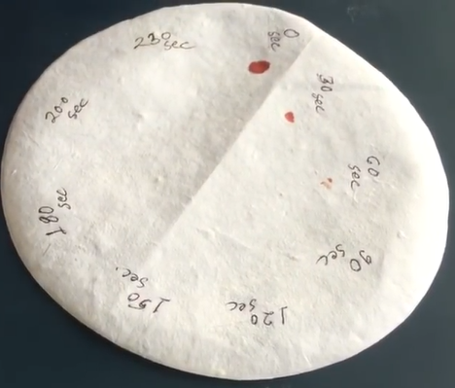
Bleeding time

Slide 16
Precautions
The skin site chosen for BT should be scrubbed well with alcohol to increase the blood flow.
The skin should be dry and the puncture should be 3–4 mm deep to give free-flowing blood. Do not squeeze.

Slide 17
Precautions
Do not press the filter paper on the puncture site.
If bleeding continues for more than 10–12 minutes, stop the test and press a sterile gauze on the wound & inform your instructor.

Slide 18
CLOTTING TIME
Clotting time (CT) (coagulation time): is the time interval between the entry of blood into the glass capillary tube and formation of fibrin threads.
The clotting of blood involves both the intrinsic and the extrinsic systems of clotting;
Injury to the blood (intrinsic pClotting time (CT) (coagulation time): is the time interval between the entry of blood into the glass capillary tube and formation of fibrin threads.
The clotting of blood involves both the intrinsic and the extrinsic systems of clotting;
Injury to the blood (intrinsic pathway).
Injury to the tissues (extrinsic pathway).
athway).
Injury to the tissues (extrinsic pathway).
Notes:
In vitro clotting due to intrinsic pathway (trauma to the blood)

Slide 19
CLOTTING TIME
Clotting time depends on:
Nature of contact surface.
Presence or absence of clotting factors.
Temperature.
Notes:
Temperature: Low temperature may prolong the CT.

Slide 20
NORMAL VALUE
Normal clotting time = 3–6 minutes.
The CT is prolonged in hemophilia and other clotting disorders, because thrombin cannot normally be generated. Yet, the BT, which reflects platelet plug formation and vasoconstriction, independently of clot formation, is normal.
Notes:
Hemophilia has normal BT but prolonged CT
Purpura has prolonged BT but normal CT

Slide 21
INCREASED CLOTTING TIME
Hereditary coagulation disorders
Hemophilias
Von Willebrand disease
Afibrinogenemia and dysfibrinogenemia
Deficiency of factor XIII
Notes:
The Clotting Time is decreased in: Physiological conditions: malnutrition, parturition. Pathological conditions: There is no pathological condition in which the CT is decreased.

Slide 22
INCREASED CLOTTING TIME
Acquired coagulation disorders
Vitamin K deficiency
Liver diseases
Intravascular clotting
Anticoagulant therapy
Newborns
Notes:
Hemophilia has normal BT but prolonged CT
Purpura has prolonged BT but normal CT

Slide 23
Notes:
Vitamin K (important for activation of certain clotting factor - factors II (prothrombin), VII, IX and X-)
Hemophilia (deficiency of factor 8 VIII)
A Fibrinogenemia (defiency of fibrinogen)
Anticoagulant materials (prevent clotting)
In vivo (drugs – warfarine (affecting Vit K), heparin (affecting Thrombin)
In vitro (citrate & oxalate (causes precipitation of calcium- inters in all pathways)

Slide 24
Materials
Equipment for sterile finger-prick
Glass capillary tubes (non heparinised)
Stopwatch

Slide 25
PROCEDURE
Absorb the first 2 drops of blood on a separate filter paper and allow a large drop to form. Now dip one end of the capillary tube in the blood; the blood rises into the tube by capillary action.
Note the time when blood starts to enter the tube. This is the zero time.

Slide 26
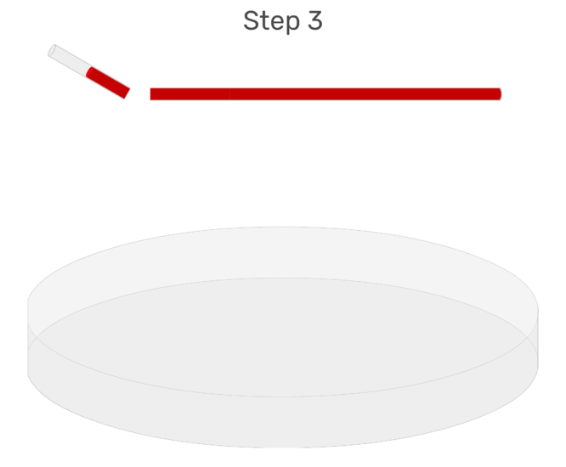
GLOTTING TIME

Slide 27
PROCEDURE
Hold the capillary tube between the palms of your hands to keep the blood near body temperature.
After 2 minutes, gently break off 1 cm bits of glass tube from one end, at intervals of 30 seconds, and look for the formation of fibrin threads between the broken ends.

Slide 28
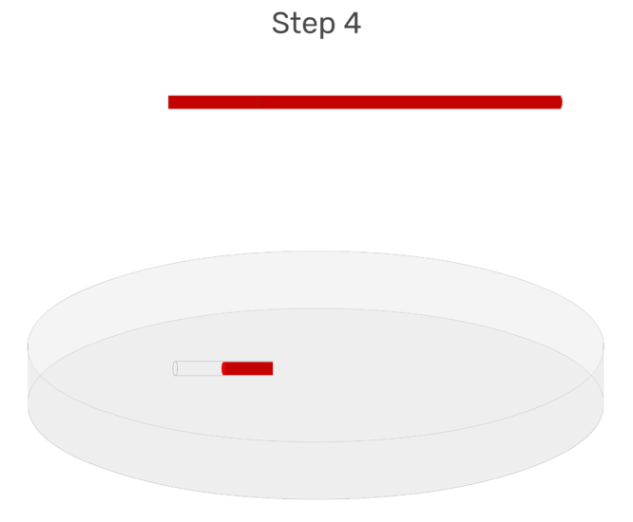
GLOTTING TIME

Slide 29
PROCEDURE
The end-point is reached when fibrin threads span a gap of 5 mm between the broken ends (“rope formation”). Note the time.
Clotting time= 2 + No. pieces / 2
Normal clotting time = 3–6 minutes.

Slide 30
CLINICAL SIGNIFICANT OF BT & CT
History of frequent and persistent bleeding from minor injuries, or spontaneous bleeding into tissues.
Before every minor and major surgery (tooth extraction, etc.).

Slide 31
CLINICAL SIGNIFICANT OF BT & CT
Before taking biopsy, especially from bone marrow, liver, kidney, etc.
Before and during anticoagulant therapy.
Family history of bleeding disorders.

